Slide 1
AI & Automation
How to use AI and Automation in the Squadron
Capt. Erich Deitenbeck
Des Moines Composite Squadron

Slide 2
Why This Matters
AI and Automation are already in your daily work
CAP volunteers and time-constrained
Goal: Reduce workload and improve efficiency
Artificial Intelligence

Slide 3
I. Understanding AI
Artificial Intelligence is software designed to perform tasks that normally require human judgment, reasoning, pattern recognition, or language understanding.

Slide 4
I. Understanding AI
Artificial Intelligence is software designed to perform tasks that normally require human judgment, reasoning, pattern recognition, or language understanding.
Uses logic, search, reasoning, or learned patterns.
Artificial Intelligence
Examples:
Playing Chess
Grammarly
Spell check

Slide 5
I. Understanding AI
Artificial Intelligence is software designed to perform tasks that normally require human judgment, reasoning, pattern recognition, or language understanding.
Uses logic, search, reasoning, or learned patterns.
Artificial Intelligence
Learns patterns from examples.
Machine Learning
Examples:
Netflix recommendations
Fraud detection
Spam detection

Slide 6
I. Understanding AI
Artificial Intelligence is software designed to perform tasks that normally require human judgment, reasoning, pattern recognition, or language understanding.
Uses logic, search, reasoning, or learned patterns.
Artificial Intelligence
Learns patterns from examples.
Machine Learning
Uses large neural networks to learn complex patterns.
Deep Learning
Examples:
Facial Recognition
Speech Recognition
Image Recognition

Slide 7







I. Understanding AI
COMMON AI TOOLS:

Slide 8
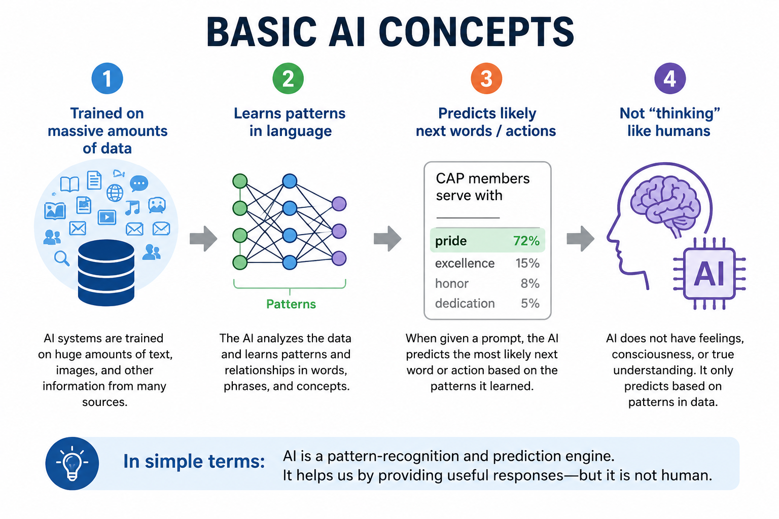
I. Understanding AI

Slide 9
I. Understanding AI
Strengths:
Fast Drafting
Summarization
Brainstorming
Data Analysis

Slide 10
I. Understanding AI
Strengths:
Fast Drafting
Summarization
Brainstorming
Data Analysis
Limitations:
May confidently provide incorrect information
May invent facts or references
Security / Privacy Concerns
Not a substitute for expertise
Needs human review

Slide 11
I. Understanding AI
When NOT to use AI:
Sensitive information
Personal information
Medical advice
Legal decisions

Slide 12
I. Understanding AI
CAP’s Approach:
CAPP 150-4 - Use of Artificial Intelligence in Public-facing Content
  Human-first, authenticity-focused approach: The guide emphasizes prioritizing real photos, videos, and stories over AI-generated content to maintain credibility, integrity, and public trust.
  Risks of AI-generated content: AI can unintentionally alter details (uniforms, equipment, people, or scenes), reduce creator control, and introduce privacy or security concerns—potentially misrepresenting the organization.
  Appropriate use of AI: AI is encouraged for supportive tasks like transcription, translation, content planning, analytics, and refining writing—but not for replacing human creativity or generating core content.
  Guidance for visuals and design: Editing real images with AI-assisted tools is generally acceptable if it improves clarity and accuracy, but generating new or heavily altered imagery is discouraged for public-facing use.

Slide 13
II. AI Demonstration
COMMON AI TOOLS:

Slide 14
II. AI Demonstration
COMMON AI TOOLS:

Slide 15
II. AI Demonstration
LIMITATIONS
10 files / chat
100MB / file
Limited number of chats
Agents
  4 websites, 1 level deep
  No documents
Max 3 docs in a chat.
Limited number of chats

Slide 16
II. AI Demonstration
Scenarios:
  #1: Summarization
  #2: Writing Assistance
  #3: CAP Regulations

Slide 17
II. AI Demonstration
  #1: Summarization
      Get a summary of emails and attachments
      Already built into Outlook using Copilot

Slide 18
II. AI Demonstration
  #2: Writing Assistance
      For initial or review
      Requires thoughtful prompts
      Try to use references

Slide 19
II. AI Demonstration
  #3: CAP Regulations
      Requires organization and upload
      Always review the answers

Slide 20

Automation
Automation = If This Happens → Do That
Examples:
Form submitted → Send email
New member joins → Notify commander
Meeting date changes → Update calendar
Power Automate

Slide 21
Automation
Uses for Automation:
  Repetitive business tasks
  Approvals
  Notifications
  Moving data between systems
  Automating workflows
Power Automate

Slide 22
Automation
Demonstration:
  #1: Email Reminders
  #2: Form submission
Power Automate

Slide 23
Automation
#1: Email Reminders
  Scheduled reminders to members
  Limitation
    Wing does not allow groups
    Requires extra work for changes
Power Automate

Slide 24
Automation
#2: Form submission
  Automation based on answers
Power Automate

